Slide 1
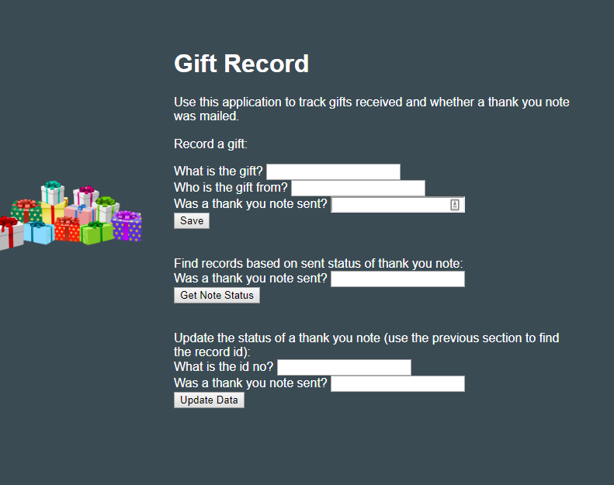
Gift Record
Track gifts that have been received and whether thank you notes have been sent out or not.
Demo
<http://marist-project-bluemix-kr.mybluemix.net/>

Slide 2
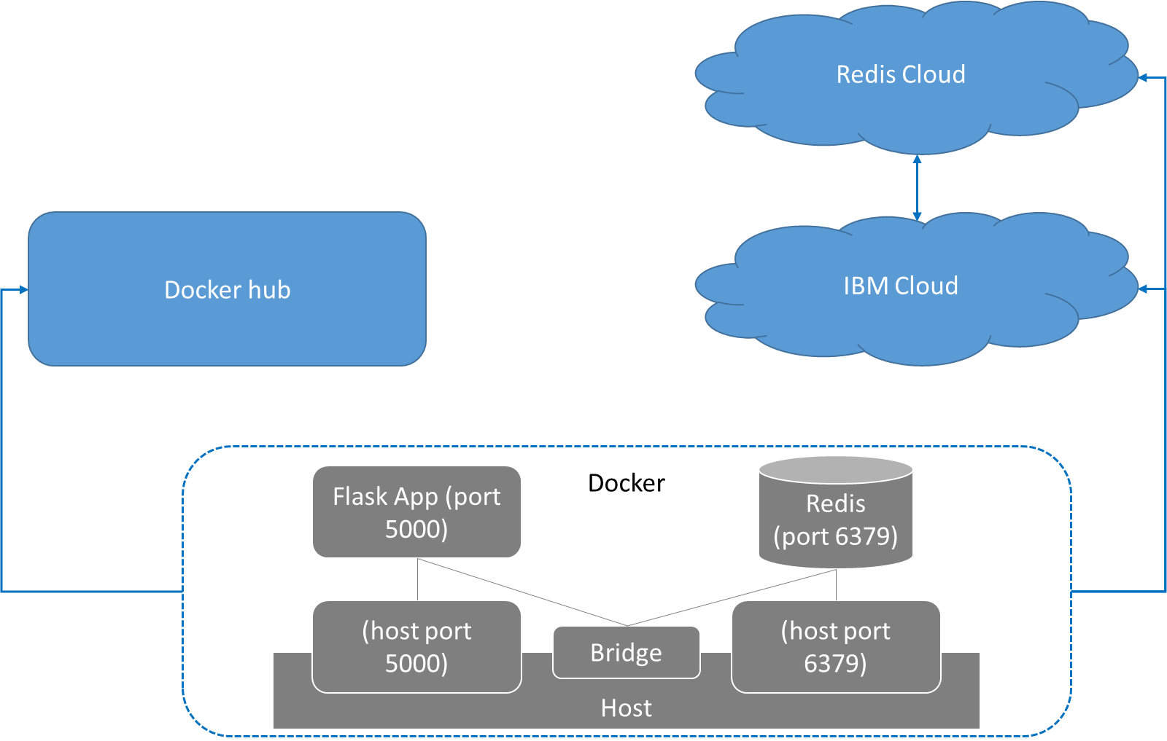
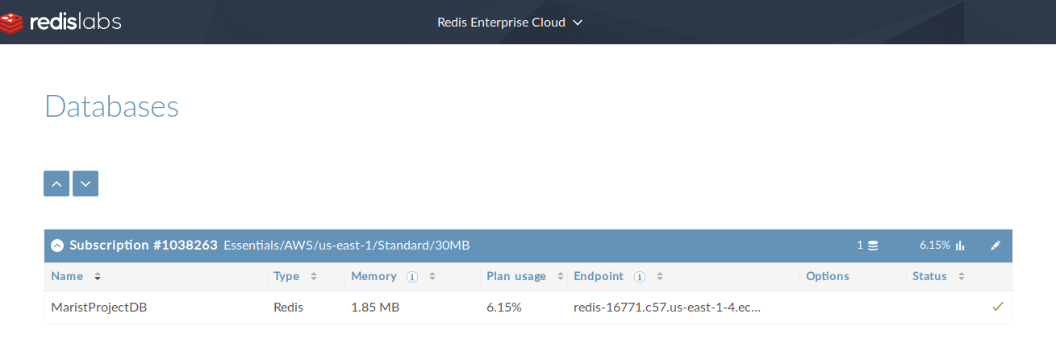
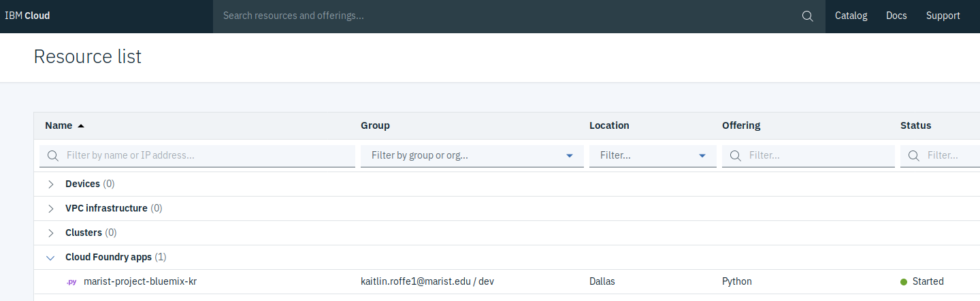
Architecture
The application uses a Flask framework and Redis database
A demo has been posted to IBM Cloud with a connector to a database hosted on Redis Enterprise Cloud

Slide 3
Get It Now
Containerized application available on Docker Hub.
Download
<https://hub.docker.com/repository/docker/katiero/giftlog/tags?page=1>
Code and setup instructions available on GitHub
https://github.com/katiero/marist-mscs621-2019-kaitlin-roffe

